Slide 1
Unit 3: Content
System Development method:
  STRADIS – Chapter 20 pp 395 – 402
Approach:
  Process modelling: Functional decomposition Chapter 6 pp 107 – 111
Techniques
  Data flow diagrams, Data Structure Diagrams, Decision trees, Decision tables, Structured English, Normalisation – Chapter 12 pp 242 – 272
D de Villiers : 29th July 2014

Slide 2
Chapter 20
Process-Oriented
Methodologies

Slide 3
STRADIS
Initial study
Detailed study
Defining and designing alternative solutions
Physical design

Slide 4
Detailed study
A definition of the user community for a new system, that is, the names and responsibilities of senior executives, the functions of affected departments, the relationships among affected departments, the descriptions of clerical jobs that will be affected, and the number of people in each clerical job, hiring rates, and natural attrition rates
A logical model of the current system, that is, an overall data flow diagram, the interfacing systems (if relevant), a detailed data flow diagram for each important process, the logic specification for each basic process at an appropriate level of detail, and the data definitions at an appropriate level of detail
A statement of increased revenue/avoidable cost/improved service that could be provided by an improved system, including the assumptions, the present and projected volumes of transactions and quantities of stored data, and the financial estimates of benefits where possible
An account of competitive/statutory pressures (if any) including the system cost and a firm cost/time budget for the next phase (defining a menu of possible alternatives)

Slide 5
STRADIS: Stage 3 report
A DFD of the current system
The limitations of the current system, including the cost and benefit estimates
The logical DFD of the new system
For each of the identified alternatives, the design will include
statements covering:
The parts of the DFD that would be implemented
The user interface (terminals, reports, query facilities, and so on)
The estimated costs and benefits
The outline implementation schedule
The risks involved

Slide 6
STRADIS: Physical design
The professional time and computer test time required to develop the identified modules
The computer system required
The peripherals and data communication costs
The professional time required to develop user documentation and train users
The time of the users who interact with the system
The professional time required to maintain and enhance the system during its lifetime

Slide 7
Chapter 12
Process Techniques

Slide 8
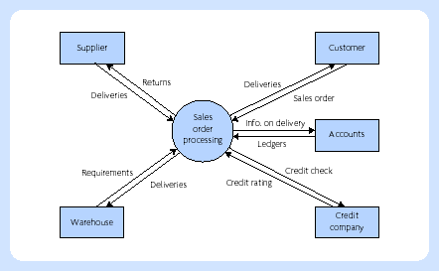
Data flow diagramming
Context diagram

Slide 9
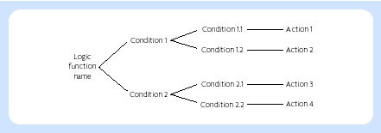
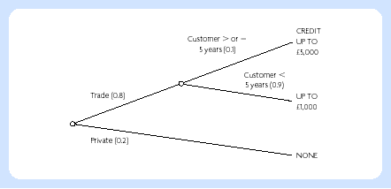
Decision trees

Slide 10
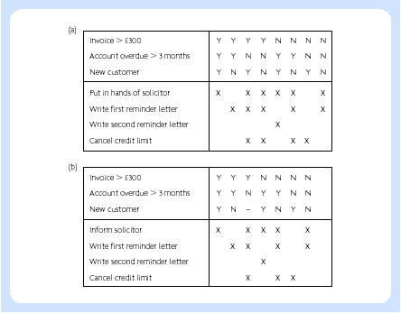
Decision tables
Consolidating decision tables

Slide 11
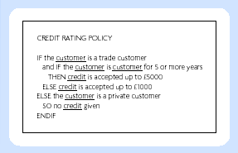
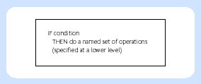
Structured English
Structured English
example
IF . . . THEN
construct

Slide 12
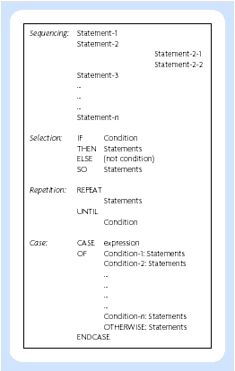
Structured English
The basic structures
of structured english

Slide 13
Structured English
• sequencing shows the order of processing of a group of instructions, but has no repetition or branching built into it
• selection facilitates the choice of those conditions where a particular action or set of actions (or another decision and selection) are to be carried out
• cases represent a special type of decision structure (a special kind of selection), where there are several possibilities, but they never occur in combination (in other words, they are mutually exclusive)
• repetition or loop instructions facilitate the same action or set of actions to be carried out a number of times, depending on a conditional statement

Slide 14
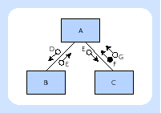
Structure diagrams
• Module A can call module B and also module C. This is shown by lines joining the boxes, which represent modules. No sequencing for these calls nor whether they actually occur is implied by the diagramming notation. When the subordinate process terminates, control goes back to the calling process.
• When A calls B, it sends data of type D to B. When B terminates, it returns data of type E to A. Similarly, A communicates with C using data of types E and G.
• When C terminates, it sends a flag of type F to A. A flag is used as a flow of control data. The difference in the symbol between data types and flags lies in the circle being filled in or not.

Slide 15
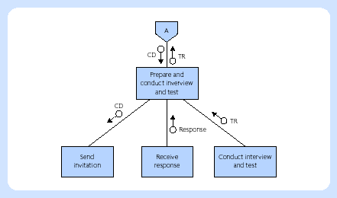
Structure diagrams
Structure diagram for interviewing and testing applications

Slide 16
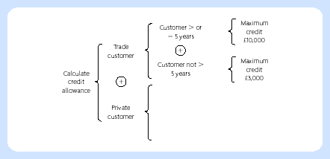
Structure diagrams
Warnier–Orr diagram

Slide 17
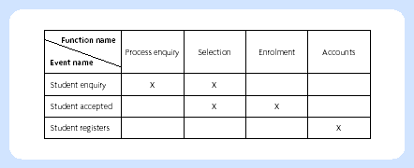
Matrices
Function/event matrix

Slide 18
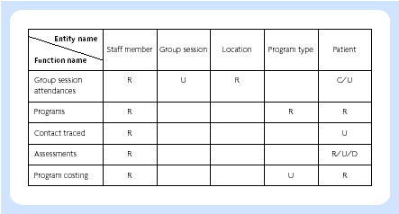
Matrices
Entity/function matrix (CRUD matrix)

Slide 19
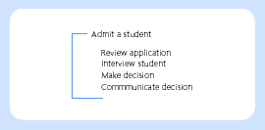
Action diagram

Slide 20
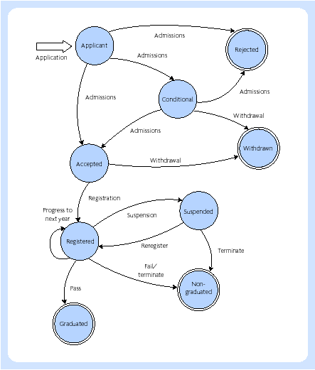
Entity life cycle
Entity life cycle for
the entity student

Slide 21
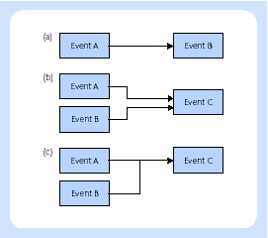
Entity lifecycle
Dependencies between events

Slide 22
Chapter 6
Modelling Themes

Slide 23
Model
A model is an abstraction, a simplified representation

Slide 24
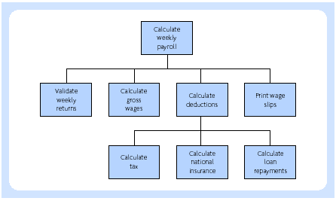
Functional decomposition

Slide 25
Data model
It is a model which is readily understandable by both developers and users because of its graphical form
It is independent of any physical implementation, i.e. it is at a logical level
It does not show bias towards particular users or departmental views. The data model can reflect a variety of different views of the data

